Slide 1
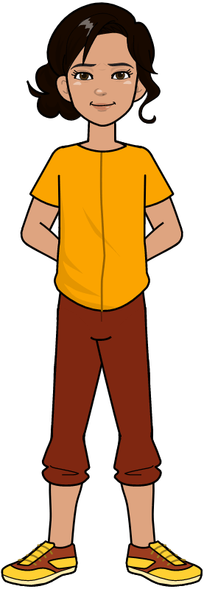
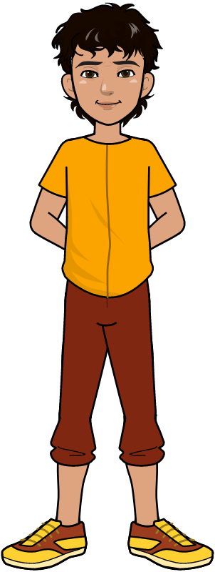
Repetition Structures

Slide 2
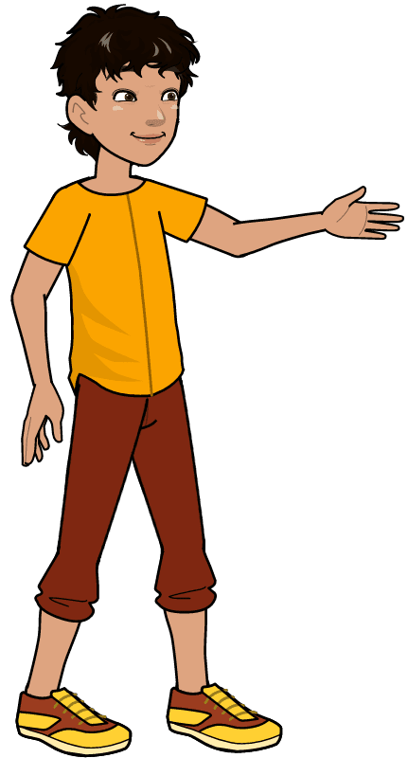
Revision: Print sum of two numbers
Let’s say we want to print the sum of two numbers.
# This program adds two numbers num1 = 1 num2 = 3 sum = float(num1) + float(num2) print('The sum is = '+ str(sum)) -------------------------------- The sum is = 4
Statement 1
Statement 2
Statement 3
Statement 4
Output

Slide 3
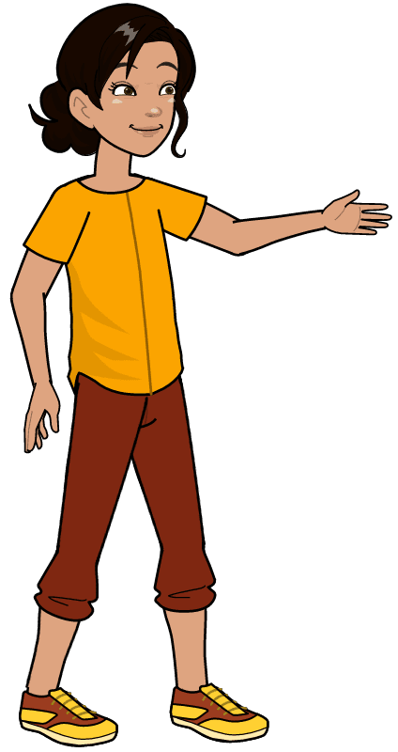
Print sum
Let’s say we want to print sum of odd number from 1 to 10.
# This program adds five numbers num1 = 1 num2 = 3 num3 = 5 num4 = 7 num5 = 9 sum = float(num1) + float(num2)+ float(num3) + float(num4) + float(num5)+ print('The sum is = '+ str(sum)) -------------------------------- The sum is = 25

Slide 4
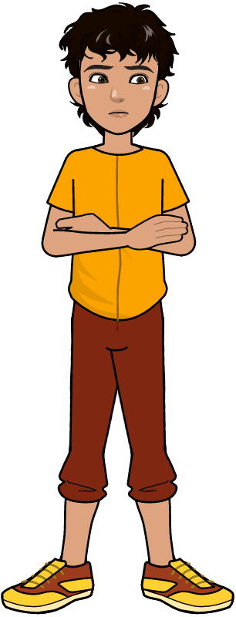
Print sum
Let’s say we want to print sum of odd number from 1 to 100 or may be Sum of odd number from 1 to 1000.
# This program adds five numbers num1 = 1 num2 = 3 num3 = 5 num4 = 7 num5 = 9 sum = float(num1) + float(num2)+ float(num3) + float(num4) + float(num5)+ print('The sum is = '+ str(sum)) -------------------------------- The sum is = 25

Slide 5
Code Repetition: Problem
Is there a way, we don’t have to repeat the same instructions again and again?

Slide 6
Code Repetition: Solution
In High level languages, Loops are used to repeat the same command without writing it multiple times.

Slide 7
Control structures: Iteration or looping
The iteration statement allows instructions to be executed until a certain condition is to be fulfilled. The iteration statements are also called as loops or Looping statements.
OR
Loops can execute a block of code number of times until a certain condition is met.
Condition
Code Block
Iteration

Slide 8
Loops
In Loop, the program knows beforehand about how many times a specific instruction or set of instructions will be executed.
Initial Statement
Loop Condition
Update statement
Keyword
for (int x = 1; x < 100; x = x + 2 )
{
//body
}
Body of Loop

Slide 9
Loop in Python
In Loop, the program knows beforehand about how many times a specific instruction or set of instructions will be executed. This is called Counter Loop
Loop Condition
Initial Statement
Update statement
Keyword
for x in range (1,100,2)
{
//body
}
Body of Loop

Slide 10
Counter Loop: Working Example
Let’s say we want to print sum of odd number from 1 to 100 or may be Sum of odd number from 1 to 1000.
# This program adds 100 odd numbers sum = 0 for x in range (1,100,2): sum = sum + x print('The sum is = '+ str(sum)) -------------------------------- The sum is = 2500

Slide 11
Initial Statement
Loop Condition
Body of for Loop
Update Statement
true
False

Slide 12
Loops
Now, What if we don’t know beforehand how many times a set of instructions will be executed?

Slide 13
Loops
Then we will use Conditional Loops. I.e., we will execute the loop until a certain condition is met.
Keyword
Loop Condition
while (condition)
{
//body
}
Body of Loop

Slide 14
Loops in Python
Then we will use Conditional Loops. I.e., we will execute the loop until a certain condition is met.
Keyword
Loop Condition
while (condition):
//body
Body of Loop

Slide 15
Conditional Loop: Working Example
Suppose, the requirement is to keep taking numbers as input from the user until the user enters -1.

Slide 16
Conditional Loop: Working Example
Suppose, the requirement is to keep taking numbers as input from the user until the user enters -1.
# This program adds 100 odd numbers num = 0 while (num != -1): print(‘Enter -1 to exit.’) num = int(input(‘Enter a number: ’)) -------------------------------- Enter -1 to exit. Enter a numer: -1

Slide 17
Loop Condition
Body of while loop
true
False

Slide 18
Code Repetition: Problem
Is there any way, we can stop the loop before it has looped through all the items?

Slide 19
Code Repetition: Solution (Break)
fruits = ["apple", "banana", "cherry"]
for x in fruits:
print(x)
if x == "banana":
break
//Remaining code
apple
banana
Output

Slide 20
Code Repetition: Problem
Is there any way, we can stop the current iteration of the loop, and continue with the next?

Slide 21
Code Repetition: Solution (Continue)
fruits = ["apple", "banana", "cherry"]
for x in fruits:
if x == "banana":
continue
print(x)
//Remaining code
apple
cherry
Output

Slide 22
Working Example
Write a Program that prints your Name for a given number of times you want.

Slide 23
Lets See Practical

Slide 24

Learning Outcome
In this lecture, we learnt how to write a Python Program that repeats a Set of Instructions for a specific number of times to solve the given problem using Loops.

Slide 25
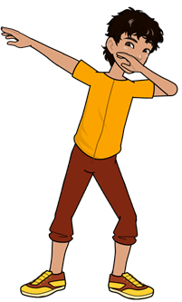
Conclusion
Loops are of 2 types
1. Sequence-Controlled / Counter (For Loop) Loops.
2. Sentinel controlled / Conditional (While) Loops
In Counter Loop, the program knows beforehand about how many times a specific instruction or set of instructions will be executed.
In Conditional Loop, the program doesn’t know
the number of instruction to be executed.

Slide 26

Self Assessment
Write a python Program that asks the user to enter 5 numbers, one at a time, and add them together. This is called a Running Total. Once the user is done, display the total sum on the Console.

Slide 27

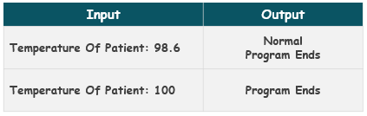
Self Assessment
Solve the Following Programs
1. Write a program that takes the temperature of a patient in Fahrenheit as input and prints “Normal” if the temperature is equal to 98.6
Test Cases

Slide 28
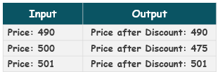
Self Assessment
Solve Following Programs
2. Write a Program that takes the total price of the items bought by a customer. If the price is exactly equal to 500$ then it gives an overall 5% discount to the customer and displays the updated price.
Test Cases

Slide 29
Self Assessment
Solve Following Programs
3. Write a program which takes a number as input from the user. If the number is more than 200 it asks the user to enter 4 more numbers and displays the sum of the first 2 numbers and multiplication of the last 2 numbers on separate lines.

Slide 30
Self Assessment
Solve Following Programs
4. Write a program which takes a number from the user if the number is not equal to 200, it asks the user to enter 4 more numbers and displays the result after subtracting the first 2 numbers and dividing the last 2 numbers.

